Slide 1
Cloning Workshop
Presented by Alex Klenov (PipetteJockey)
Introduction
Refined to have a high success rate for most applications
Not the fastest, more upfront work with purification
Save time/money by not having to repeat an experiment
Focus on overlap based cloning techniques like Gibson/Hifi/TEDA (vs. restriction enzymes, Golden Gate as exception)
Step 1: Design Experiment
Step 2: Prepare Fragments
Scope
Step 3: Assemble Fragments
For beginners -> intermediate level
Step 4: Transform Cells
Caveats/Limitations
Many, many, many other methods are out there
Some may be better suited for your application
ANY method that gives you your desired clone is fair game
Step 5: Screen Colonies
Do Stuff with Clones

Slide 2
What are the general operations we want to do when cloning?
Number of
Fragments
Operation
Technique
Make a point mutation/substitution (A few bp within ~50bp window)
Make a deletion (Any size)
Make a small insertion (Less than ~50bp)
Transfer DNA from plasmid -> plasmid (“sub-cloning”)
Insert synthesized DNA into plasmid
Insert genomic DNA into plasmid
Clone gene from mRNA into plasmid
Multi-fragment assemblies
Make a substitution (Alternative)
Make a deletion (Alternative)
Make a small insertion (Alternative)
1 Fragment
KLD
Mutagenesis
1 Vector
1 Insert
(2 Fragments)
TEDA assembly
Gibson assembly
Hifi assembly
Golden Gate assembly
1 Vector
>1 Insert
(>2 fragments)
TEDA assembly
Gibson assembly
Hifi assembly
Golden Gate assembly

Slide 3
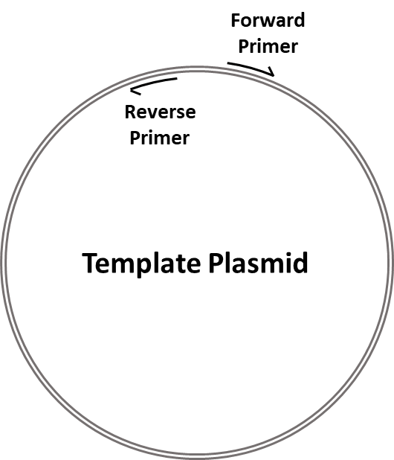
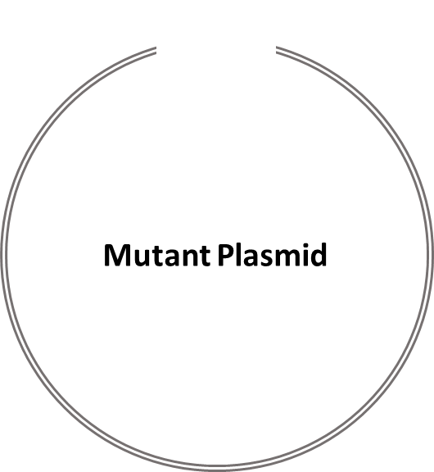
What is KLD mutagenesis?
- Efficiently circularizes blunt ended dsDNA fragment, one pot reaction
- Sold as Q5 Mutagenesis kit -> NEB -> $$$
- Easily homebrewed!
- Kinase – Phosphorylates blunt ends
- Ligase – Ligates blunt ends
- DpnI – Degrades template plasmid
PCR
…
…
gcagcaagattcaagtacatagagaat
cgtcgttctaagttcatgtatctctta
3’5’
caggtgaaaactaattttaacagagcattcaaccctaatcccaaagtacttaatttgca
gtccacttttgattaaaattgtctcgtaagttgggattagggtttcatgaattaaacgt
5’
3’
Kinase
…
5’
DpnI
P
…
gcagcaagattcaagtacatagagaat
cgtcgttctaagttcatgtatctctta
3’OH
caggtgaaaactaattttaacagagcattcaaccctaatcccaaagtacttaatttgca
gtccacttttgattaaaattgtctcgtaagttgggattagggtttcatgaattaaacgt
P
5’
OH 3’
Ligase
…
…
5’
3’
gcagcaagattcaagtacatagagaatcaggtgaaaactaattttaacagagcattcaaccctaatcccaaagtacttaatttgca
cgtcgttctaagttcatgtatctcttagtccacttttgattaaaattgtctcgtaagttgggattagggtttcatgaattaaacgt
Template Plasmid
Digested
(Methylated in E. coli)
DpnI
No digestion of PCR Product
(No methylation)

Slide 4
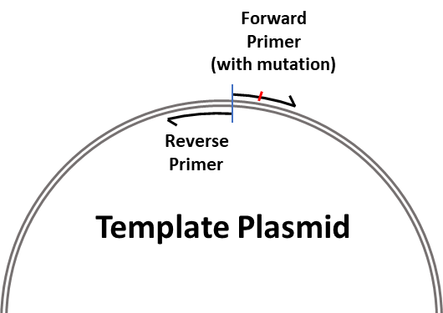
Operation: Make a point mutation/substitution
Multiple mutations can be contained in one primer or distributed in both!
…
…
5’
3’
gcagcaagattcaagtacatagagaatcaggtgaaaactaattttaacagagcattcaaccctaatcccaaagtacttaatttgca
cgtcgttctaagttcatgtatctcttagtccacttttgattaaaattgtctcgtaagttgggattagggtttcatgaattaaacgt
Substitution
Example
How?
…
…
5’
3’
gcagcaagattcaagtacatagagaatcaggtgaaaactaTttttaacagagcattcaaccctaatcccaaagtacttaatttgca
cgtcgttctaagttcatgtatctcttagtccacttttgatAaaaattgtctcgtaagttgggattagggtttcatgaattaaacgt
Forward Primer (with mutation)
…
5’ caggtgaaaactaTttttaacagagca 3’
gcagcaagattcaagtacatagagaatcaggtgaaaactaattttaacagagcattcaaccctaatcccaaagtacttaatttgca
cgtcgttctaagttcatgtatctcttagtccacttttgattaaaattgtctcgtaagttgggattagggtttcatgaattaaacgt
3’ ttctaagttcatgtatctctta 5’
5’
3’
…
Reverse Primer
PCR
…
…
gcagcaagattcaagtacatagagaat
cgtcgttctaagttcatgtatctctta
3’5’
caggtgaaaactaTttttaacagagcattcaaccctaatcccaaagtacttaatttgca
gtccacttttgatAaaaattgtctcgtaagttgggattagggtttcatgaattaaacgt
5’
3’
KLD
…
…
5’
3’
gcagcaagattcaagtacatagagaatcaggtgaaaactaTttttaacagagcattcaaccctaatcccaaagtacttaatttgca
cgtcgttctaagttcatgtatctcttagtccacttttgatAaaaattgtctcgtaagttgggattagggtttcatgaattaaacgt

Slide 5
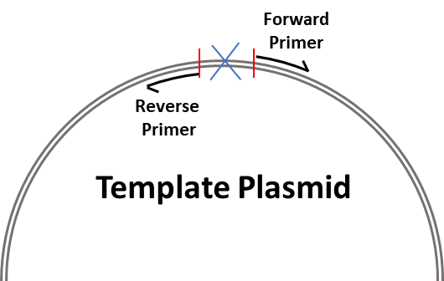
Operation: Make a deletion
Deletion can be any size!
Trim fat from a vector? Remove signal sequence? Easy!
…
…
5’
3’
gcagcaagattcaagtacatagagaatcaggtgaaaactaattttaacagagcattcaaccctaatcccaaagtacttaatttgca
cgtcgttctaagttcatgtatctcttagtccacttttgattaaaattgtctcgtaagttgggattagggtttcatgaattaaacgt
Deletion
Example
How?
…
…
5’
3’
gcagcaagattcaagtacatagagaatcaggtgcattcaaccctaatcccaaagtacttaatttgca
cgtcgttctaagttcatgtatctcttagtccacgtaagttgggattagggtttcatgaattaaacgt
Forward Primer
…
5’ cattcaaccctaatcccaaagtact 3’
gcagcaagattcaagtacatagagaatcaggtgaaaactaattttaacagagcattcaaccctaatcccaaagtacttaatttgca
cgtcgttctaagttcatgtatctcttagtccacttttgattaaaattgtctcgtaagttgggattagggtttcatgaattaaacgt
3’ aagttcatgtatctcttagtccac 5’
5’
3’
…
Reverse Primer
PCR
…
gcagcaagattcaagtacatagagaatcaggtg
cgtcgttctaagttcatgtatctcttagtccac
…
3’5’
cattcaaccctaatcccaaagtacttaatttgca
gtaagttgggattagggtttcatgaattaaacgt
5’
3’
KLD
…
…
5’
3’
gcagcaagattcaagtacatagagaatcaggtgcattcaaccctaatcccaaagtacttaatttgca
cgtcgttctaagttcatgtatctcttagtccacgtaagttgggattagggtttcatgaattaaacgt

Slide 6
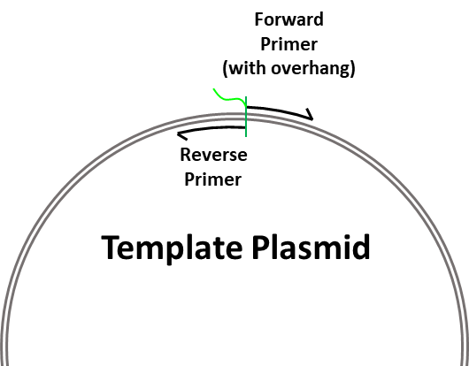
Operation: Make a small insertion
Insert can be on one primer or BOTH (~25bp from each, up to ~50bp insertion)
Insert can be as big as PCR will tolerate
…
…
5’
3’
gcagcaagattcaagtacatagagaatcaggtgaaaactaattttaacagagcattcaaccctaatcccaaagtacttaatttgca
cgtcgttctaagttcatgtatctcttagtccacttttgattaaaattgtctcgtaagttgggattagggtttcatgaattaaacgt
Insertion
Example
How?
…
5’
3’
…
gcagcaagattcaagtacatagagaatcaggtgaaaactaatATGCATGCATGCtttaacagagcattcaaccctaatcccaaagtacttaatttgca
cgtcgttctaagttcatgtatctcttagtccacttttgattaTACGTACGTACGaaattgtctcgtaagttgggattagggtttcatgaattaaacgt
Forward Primer (with overhang)
5’ ATGCATGCATGC
…
tttaacagagcattcaaccct 3’
gcagcaagattcaagtacatagagaatcaggtgaaaactaattttaacagagcattcaaccctaatcccaaagtacttaatttgca
cgtcgttctaagttcatgtatctcttagtccacttttgattaaaattgtctcgtaagttgggattagggtttcatgaattaaacgt
3’ tatctcttagtccacttttgatta 5’
5’
3’
…
Reverse Primer
PCR
…
gcagcaagattcaagtacatagagaatcaggtgaaaactaat
cgtcgttctaagttcatgtatctcttagtccacttttgatta
…
3’5’
5’
3’
ATGCATGCATGCtttaacagagcattcaaccctaatcccaaagtacttaatttgca
TACGTACGTACGaaattgtctcgtaagttgggattagggtttcatgaattaaacgt
KLD
…
5’
3’
…
gcagcaagattcaagtacatagagaatcaggtgaaaactaatATGCATGCATGCtttaacagagcattcaaccctaatcccaaagtacttaatttgca
cgtcgttctaagttcatgtatctcttagtccacttttgattaTACGTACGTACGaaattgtctcgtaagttgggattagggtttcatgaattaaacgt

Slide 7
What are the general operations we want to do when cloning?
Number of
Fragments
Operation
Technique
Make a point mutation/substitution (A few bp within ~50bp window)
Make a deletion (Any size)
Make a small insertion (Less than ~50bp)
Transfer DNA from plasmid -> plasmid (“sub-cloning”)
Insert synthesized DNA into plasmid
Insert genomic DNA into plasmid
Clone gene from mRNA into plasmid
Multi-fragment assemblies
Make a substitution (Alternative)
Make a deletion (Alternative)
Make a small insertion (Alternative)
1 Fragment
KLD
Mutagenesis
1 Vector
1 Insert
(2 Fragments)
TEDA assembly
Gibson assembly
Hifi assembly
Golden Gate assembly
1 Vector
>1 Insert
(>2 fragments)
TEDA assembly
Gibson assembly
Hifi assembly
Golden Gate assembly

Slide 8
What is TEDA / Gibson / Hifi assembly?
Overlap based cloning techniques
Same principle for all, different blends of enzymes, different efficiencies
Varies widely in cost, easy to homebrew
Insert
CATCATCATCACAGCAGCGGCatgaaaccgcgcctgtgctttaactttcgccgccgcagcattagcccgtgctatattagcattagctatctgctggtggcgaaactgtttaaactgtttaaaattcatTGAGATCCGGCTGCTAACAAA
GTAGTAGTAGTGTCGTCGCCGtactttggcgcggacacgaaattgaaagcggcggcgtcgtaatcgggcacgatataatcgtaatcgatagacgaccaccgctttgacaaatttgacaaattttaagtaACTCTAGGCCGACGATTGTTT
AGCAGCCATCATCATCATCATCACAGCAGCGGC
TCGTCGGTAGTAGTAGTAGTAGTGTCGTCGCCG
TGAGATCCGGCTGCTAACAAAGCCCGAAAGGAAGCTGAGTTG
ACTCTAGGCCGACGATTGTTTCGGGCTTTCCTTCGACTCAAC
Destination Vector
T5 Exo
Polymerase
Ligase
AGCAGCCATCATCATCATCATCACAGCAGCGGC
TCGTCGG
GAAGCTGAGTTG
ACTCTAGGCCGACGATTGTTTCGGGCTTTCCTTCGACTCAAC
accgcgcctgtgctttaactttcgccgccgcagcattagcccgtgctatattagcattagctatctgctggtggcgaaactgtttaaactgtttaaaattcatTGAGATCCGGCTGCTAACAAA
GTAGTAGTAGTGTCGTCGCCGtactttggcgcggacacgaaattgaaagcggcggcgtcgtaatcgggcacgatataatcgtaatcgatagacgaccaccgctttgacaaatttgacaaatttta
Polymerase + Ligase (Gibson mix)
AGCAGCCATCATCATCATCATCACAGCAGCGGCatgaaaccgcgcctgtgctttaactttcgccgccgcagcattagcccgtgctatattagcattagctatctgctggtggcgaaactgtttaaactgtttaaaattcatTGAGATCCGGCTGCTAACAAAGCCCGAAAGGAAGCTGAGTTG
TCGTCGGTAGTAGTAGTAGTAGTGTCGTCGCCGtactttggcgcggacacgaaattgaaagcggcggcgtcgtaatcgggcacgatataatcgtaatcgatagacgaccaccgctttgacaaatttgacaaattttaagtaACTCTAGGCCGACGATTGTTTCGGGCTTTCCTTCGACTCAAC
Noice!

Slide 9
Operation: Transfer DNA from plasmid -> plasmid (“sub-cloning”)
Previously cloned gene, put into inducible vector
…
Your favorite gene in another vector
…
5’
3’
atgaaaccgcgcctgtgctttaactttcgccgccgcagcattagcccgtgctatattagcattagctatctgctggtggcgaaactgtttaaactgtttaaaattcat
tactttggcgcggacacgaaattgaaagcggcggcgtcgtaatcgggcacgatataatcgtaatcgatagacgaccaccgctttgacaaatttgacaaattttaagta
Your favorite His tagged vector
…
5’
3’
…
AGCAGCCATCATCATCATCATCACAGCAGCGGCTGAGATCCGGCTGCTAACAAAGCCCGAAAGGAAGCTGAGTTG
TCGTCGGTAGTAGTAGTAGTAGTGTCGTCGCCGACTCTAGGCCGACGATTGTTTCGGGCTTTCCTTCGACTCAAC
General design steps:
Make an in silico mock-up, check reading frame etc
Choose overlaps
Design overlaps (20-40bp) into your insert primers, into your vector primers or both
Left Overlap
Right Overlap
Mock-up
…
5’
3’
…
AGCAGCCATCATCATCATCATCACAGCAGCGGCatgaaaccgcgcctgtgctttaactttcgccgccgcagcattagcccgtgctatattagcattagctatctgctggtggcgaaactgtttaaactgtttaaaattcatTGAGATCCGGCTGCTAACAAAGCCCGAAAGGAAGCTGAGTTG
TCGTCGGTAGTAGTAGTAGTAGTGTCGTCGCCGtactttggcgcggacacgaaattgaaagcggcggcgtcgtaatcgggcacgatataatcgtaatcgatagacgaccaccgctttgacaaatttgacaaattttaagtaACTCTAGGCCGACGATTGTTTCGGGCTTTCCTTCGACTCAAC
Insert-Forward
Vector-Forward
Primer
Design
5’CATCATCATCACAGCAGCGGCatgaaaccgcgcctgtgc 3’
5’ TGAGATCCGGCTGCTAACAAA 3’
AGCAGCCATCATCATCATCATCACAGCAGCGGCatgaaaccgcgcctgtgctttaactttcgccgccgcagcattagcccgtgctatattagcattagctatctgctggtggcgaaactgtttaaactgtttaaaattcatTGAGATCCGGCTGCTAACAAAGCCCGAAAGGAAGCTGAGTTG
TCGTCGGTAGTAGTAGTAGTAGTGTCGTCGCCGtactttggcgcggacacgaaattgaaagcggcggcgtcgtaatcgggcacgatataatcgtaatcgatagacgaccaccgctttgacaaatttgacaaattttaagtaACTCTAGGCCGACGATTGTTTCGGGCTTTCCTTCGACTCAAC
3’ GTAGTAGTAGTGTCGTCGCCG 5’
3’ tttgacaaattttaagtaACTCTAGGCCGACGATTGTTT 5’
Vector-Reverse
Insert-Reverse
Insert-Forward
5’CATCATCATCACAGCAGCGGCatgaaaccgcgcctgtgc 3’
PCR using insert containing plasmid as template
Order
These
Primers
Insert-Reverse
3’ tttgacaaattttaagtaACTCTAGGCCGACGATTGTTT 5’
Vector-Forward
5’ TGAGATCCGGCTGCTAACAAA 3’
PCR using destination plasmid as template
Vector-Reverse
3’ GTAGTAGTAGTGTCGTCGCCG 5’

Slide 10
Your favorite gene in another vector
Insert-Forward
5’CATCATCATCACAGCAGCGGCatgaaaccgcgcctgtgc 3’
…
…
5’
3’
atgaaaccgcgcctgtgctttaactttcgccgccgcagcattagcccgtgctatattagcattagctatctgctggtggcgaaactgtttaaactgtttaaaattcat
tactttggcgcggacacgaaattgaaagcggcggcgtcgtaatcgggcacgatataatcgtaatcgatagacgaccaccgctttgacaaatttgacaaattttaagta
3’ tttgacaaattttaagtaACTCTAGGCCGACGATTGTTT 5’
Insert-Reverse
PCR
Insert Fragment
CATCATCATCACAGCAGCGGCatgaaaccgcgcctgtgctttaactttcgccgccgcagcattagcccgtgctatattagcattagctatctgctggtggcgaaactgtttaaactgtttaaaattcatTGAGATCCGGCTGCTAACAAA
GTAGTAGTAGTGTCGTCGCCGtactttggcgcggacacgaaattgaaagcggcggcgtcgtaatcgggcacgatataatcgtaatcgatagacgaccaccgctttgacaaatttgacaaattttaagtaACTCTAGGCCGACGATTGTTT
Your favorite His tagged vector
Vector-Forward
…
5’
3’
5’ TGAGATCCGGCTGCTAACAAA 3’
…
AGCAGCCATCATCATCATCATCACAGCAGCGGCTGAGATCCGGCTGCTAACAAAGCCCGAAAGGAAGCTGAGTTG
TCGTCGGTAGTAGTAGTAGTAGTGTCGTCGCCGACTCTAGGCCGACGATTGTTTCGGGCTTTCCTTCGACTCAAC
3’ GTAGTAGTAGTGTCGTCGCCG 5’
Vector-Reverse
PCR
AGCAGCCATCATCATCATCATCACAGCAGCGGC
TCGTCGGTAGTAGTAGTAGTAGTGTCGTCGCCG
TGAGATCCGGCTGCTAACAAAGCCCGAAAGGAAGCTGAGTTG
ACTCTAGGCCGACGATTGTTTCGGGCTTTCCTTCGACTCAAC
Linearized Destination Vector
Gibson
+

Slide 11
Operation: Insert synthesized DNA into plasmid
Can you get a whole plasmid synthesized? Sure can, go for it!
Synthesis company doesn’t have a suitable vector? Want to do cloning yourself?
Your favorite gene
5’
3’
atgaaaccgcgcctgtgctttaactttcgccgccgcagcattagcccgtgctatattagcattagctatctgctggtggcgaaactgtttaaactgtttaaaattcat
tactttggcgcggacacgaaattgaaagcggcggcgtcgtaatcgggcacgatataatcgtaatcgatagacgaccaccgctttgacaaatttgacaaattttaagta
Your favorite His tagged vector
…
5’
3’
…
AGCAGCCATCATCATCATCATCACAGCAGCGGCTGAGATCCGGCTGCTAACAAAGCCCGAAAGGAAGCTGAGTTG
TCGTCGGTAGTAGTAGTAGTAGTGTCGTCGCCGACTCTAGGCCGACGATTGTTTCGGGCTTTCCTTCGACTCAAC
General design steps:
Make an in silico mock-up, check reading frame etc
Choose overlaps
Design overlaps into your synthesized sequence OR into your primers (Inserting into multiple vectors? Design overlaps onto vector primers)
Left Overlap
Right Overlap
Mock-up
…
5’
3’
…
AGCAGCCATCATCATCATCATCACAGCAGCGGCatgaaaccgcgcctgtgctttaactttcgccgccgcagcattagcccgtgctatattagcattagctatctgctggtggcgaaactgtttaaactgtttaaaattcatTGAGATCCGGCTGCTAACAAAGCCCGAAAGGAAGCTGAGTTG
TCGTCGGTAGTAGTAGTAGTAGTGTCGTCGCCGtactttggcgcggacacgaaattgaaagcggcggcgtcgtaatcgggcacgatataatcgtaatcgatagacgaccaccgctttgacaaatttgacaaattttaagtaACTCTAGGCCGACGATTGTTTCGGGCTTTCCTTCGACTCAAC
Order This
Insert
CATCATCATCACAGCAGCGGCatgaaaccgcgcctgtgctttaactttcgccgccgcagcattagcccgtgctatattagcattagctatctgctggtggcgaaactgtttaaactgtttaaaattcatTGAGATCCGGCTGCTAACAAA
GTAGTAGTAGTGTCGTCGCCGtactttggcgcggacacgaaattgaaagcggcggcgtcgtaatcgggcacgatataatcgtaatcgatagacgaccaccgctttgacaaatttgacaaattttaagtaACTCTAGGCCGACGATTGTTT
Vector-Forward
Primer
Design
…
5’
3’
5’ TGAGATCCGGCTGCTAACAAA 3’
AGCAGCCATCATCATCATCATCACAGCAGCGGCatgaaaccgcgcctgtgctttaactttcgccgccgcagcattagcccgtgctatattagcattagctatctgctggtggcgaaactgtttaaactgtttaaaattcatTGAGATCCGGCTGCTAACAAAGCCCGAAAGGAAGCTGAGTTG
TCGTCGGTAGTAGTAGTAGTAGTGTCGTCGCCGtactttggcgcggacacgaaattgaaagcggcggcgtcgtaatcgggcacgatataatcgtaatcgatagacgaccaccgctttgacaaatttgacaaattttaagtaACTCTAGGCCGACGATTGTTTCGGGCTTTCCTTCGACTCAAC
3’ GTAGTAGTAGTGTCGTCGCCG 5’
Vector-Reverse
Order
These
Primers
Vector-Forward
5’ TGAGATCCGGCTGCTAACAAA 3’
PCR with destination vector as template
Vector-Reverse
3’ GTAGTAGTAGTGTCGTCGCCG 5’

Slide 12
Operation: Insert genomic DNA into plasmid
or
Clone gene from mRNA into plasmid
Cost of reagents/labor
And failed exps?
Depending on difficulty/resources available, start seriously considering synthesis of insert
Lowest 2020 Price (Twist Bioscience) -> 0.07$ / bp
1000 bp -> 70$ USD, easy choice for difficult targets
How much is an hour of your time worth?
Interesting Promoter Region
Vector
Forward
Genomic DNA
Minimum: 2 primers for insert
2 primers for vector
Optional: 2+ primers to enrich target area (No overlaps)
Vector
Reverse
Your
Favorite
Plasmid
ORF
5’UTR
3’UTR
Minimum: d(T)23 VN oligo for RT
2 primers for insert
2 primers for vector
Optional: 2+ primers to enrich target area (No overlaps)
mRNA
AAAAAAAAAAAAAAAAAAAAAAA
NVTTTTTTTTTTTTTTTTTTTTTTT
Oligo d(T)23 VN

Slide 13
What are the general operations we want to do when cloning?
Number of
Fragments
Operation
Technique
Make a point mutation/substitution (A few bp within ~50bp window)
Make a deletion (Any size)
Make a small insertion (Less than ~50bp)
Transfer DNA from plasmid -> plasmid (“sub-cloning”)
Insert synthesized DNA into plasmid
Insert genomic DNA into plasmid
Clone gene from mRNA into plasmid
Multi-fragment assemblies
Make a substitution (Alternative)
Make a deletion (Alternative)
Make a small insertion (Alternative)
1 Fragment
KLD
Mutagenesis
1 Vector
1 Insert
(2 Fragments)
TEDA assembly
Gibson assembly
Hifi assembly
Golden Gate assembly
1 Vector
>1 Insert
(>2 fragments)
TEDA assembly
Gibson assembly
Hifi assembly
Golden Gate assembly

Slide 14
Operation: Multi-fragment assembly
Need to swap ORFS/promoters/signal sequences at the same time? New combinations?
Overlap 1
F1-For
General design steps:
F3-Rev
Make an in silico mock-up of whole plasmid
Choose as equally sized fragments as possible
Pick overlaps (20-40bp), design primers
Fragment 3
(F3)
Fragment 1
(F1)
F1-For
F2-Rev
F1-Rev
…
5’
3’
5’ CACATGGACGGCAAGAAGAGAAGT 3’
…
F3-For
F2-For
TAATATTTCTCGAATGCATGTTCATCACATGGACGGCAAGAAGAGAAGTATCGATTTAAAGATACATCCGAGGGATGCC
ATTATAAAGAGCTTACGTACAAGTAGTGTACCTGCCGTTCTTCTCTTCATAGCTAAATTTCTATGTAGGCTCCCTACGG
Overlap 2
3’ GTGTACCTGCCGTTCTTCTCTTCA 5’
Overlap 3
F3-Rev
Fragment 2
(F2)
F1-For + F1-Rev
F2-For + F2-Rev
F3-For + F3-Rev
PCR
---Fragment 1---
---Fragment 2---
---Fragment 3---

Slide 15
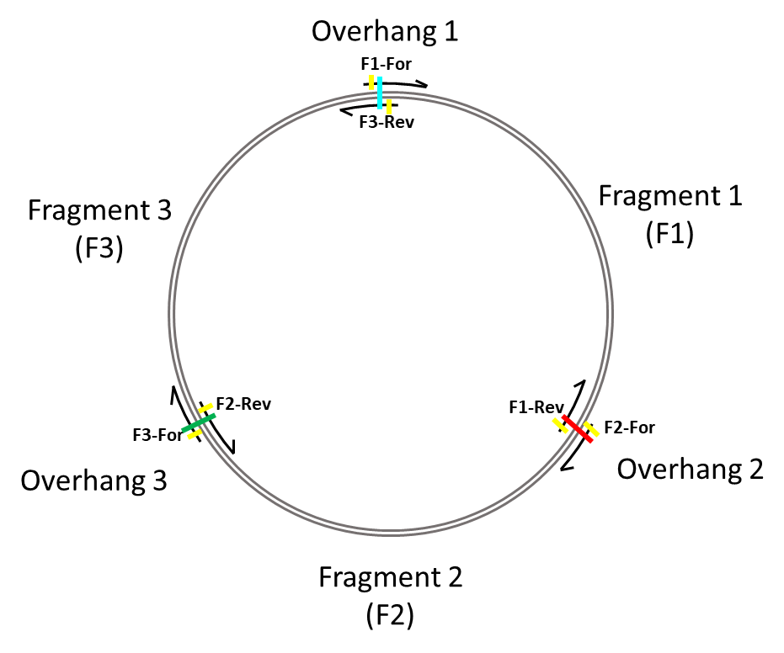
Operation: Multi-fragment assembly with Golden Gate
4+ Fragments? Golden Gate assembly!
Based on BsaI restriction enzyme cleavage distal from recognition site
General design steps:
Make an in silico mock-up of whole plasmid
Choose as equally sized fragments as possible
Pick 4bp overhang regions, design primers
“Comprehensive Profiling of Four Base Overhang Ligation Fidelity by T4 DNA Ligase and Application to DNA Assembly”
Supplemental Material
Overhang 1
Can insert mutations
Into primers…
Remove BsaI sites…
…
F1-For
5’ ACAGGTCTCCATGGACGGCAAGAAGAGAAGTATC 3’
5’
3’
TAATATTTCTCGAATGCATGTTCATCACATGGACGGCAAGAAGAGAAGTATCGATTTAAAGATACATCCGAGGGATGCC
ATTATAAAGAGCTTACGTACAAGTAGTGTACCTGCCGTTCTTCTCTTCATAGCTAAATTTCTATGTAGGCTCCCTACGG
3’ AAGAGCTTACGTACAAGTAGTGTACCTCTCTGGACA 5’
F3-Rev
PCR
…
Fragment 3
Fragment 1
…
TTCTCGAATGCATGTTCATCACATGGAGAGACCTGT 3’
AAGAGCTTACGTACAAGTAGTGTACCTCTCTGGACA 5’
5’ ACAGGTCTCCATGGACGGCAAGAAGAGAAGTATC
3’ TGTCCAGAGGTACCTGCCGTTCTTCTCTTCATAG
Digestion
…
…
TTCTCGAATGCATGTTCATCAC 3’
AAGAGCTTACGTACAAGTAGTGTACC 5’
5’ ATGGACGGCAAGAAGAGAAGTATC
3’ TGCCGTTCTTCTCTTCATAG
Ligation
…
5’
3’
TAATATTTCTCGAATGCATGTTCATCACATGGACGGCAAGAAGAGAAGTATCGATTTAAAGATACATCCGAGGGATGCC
ATTATAAAGAGCTTACGTACAAGTAGTGTACCTGCCGTTCTTCTCTTCATAGCTAAATTTCTATGTAGGCTCCCTACGG

Slide 16
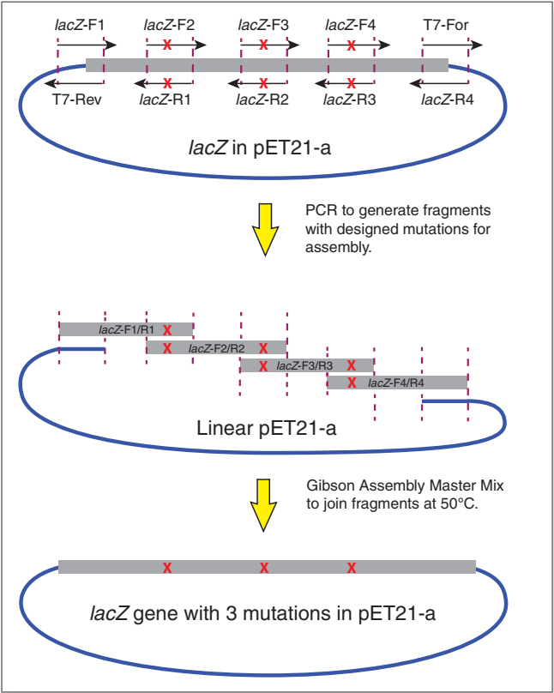
Operation: Make a point mutation (Substitution) -> Alternative
KLD relies on PCR of entire plasmid
Not always easy for large plasmids with AT/GC rich regions
What if you want multiple sites of mutation?
…
…
5’
3’
gcagcaagattcaagtacatagagaatcaggtgaaaactaattttaacagagcattcaaccctaatcccaaagtacttaatttgca
cgtcgttctaagttcatgtatctcttagtccacttttgattaaaattgtctcgtaagttgggattagggtttcatgaattaaacgt
How?
…
…
5’
3’
gcagcaagattcaagtacatagagaatcaggtgaaaactaTttttaacagagcattcaaccctaatcccaaagtacttaatttgca
cgtcgttctaagttcatgtatctcttagtccacttttgatAaaaattgtctcgtaagttgggattagggtttcatgaattaaacgt
Forward Primer (with mutation)
…
5’ caggtgaaaactaTttttaacagagca 3’
gcagcaagattcaagtacatagagaatcaggtgaaaactaattttaacagagcattcaaccctaatcccaaagtacttaatttgca
cgtcgttctaagttcatgtatctcttagtccacttttgattaaaattgtctcgtaagttgggattagggtttcatgaattaaacgt
3’ gtccacttttgatAaaaattgtctcgt 5’
5’
3’
…
Reverse Primer (also with mutation)
PCR
…
5’
3’
gcagcaagattcaagtacatagagaatcaggtgaaaactaTttttaacagagca
cgtcgttctaagttcatgtatctcttagtccacttttgatAaaaattgtctcgt
…
caggtgaaaactaTttttaacagagcattcaaccctaatcccaaagtacttaatttgca
gtccacttttgatAaaaattgtctcgtaagttgggattagggtttcatgaattaaacgt
“Improved methods for site-directed mutagenesis using Gibson Assembly® Master Mix”
3’
5’
T5 Exo
Polymerase
Ligase
Fills gap, seals nick
…
…
cctaatcccaaagtacttaatttgca
gtccacttttgatAaaaattgtctcgtaagttgggattagggtttcatgaattaaacgt
5’
3’
gcagcaagattcaagtacatagagaatcaggtgaaaactaTttttaacagagca
cgtcgttctaagttcatgtat

Slide 17
Operation: Make a deletion -> Alternative
Overhangs can be on one primer or BOTH
…
…
5’
3’
gcagcaagattcaagtacatagagaatcaggtgaaaactaattttaacagagcattcaaccctaatcccaaagtacttaatttgca
cgtcgttctaagttcatgtatctcttagtccacttttgattaaaattgtctcgtaagttgggattagggtttcatgaattaaacgt
How?
…
…
5’
3’
gcagcaagattcaagtacatagagaatcaggtgcattcaaccctaatcccaaagtacttaatttgca
cgtcgttctaagttcatgtatctcttagtccacgtaagttgggattagggtttcatgaattaaacgt
5’ gtacatagagaatcaggtg
Forward Primer (With overhang)
…
cattcaaccctaatcccaaagtact 3’
gcagcaagattcaagtacatagagaatcaggtgaaaactaattttaacagagcattcaaccctaatcccaaagtacttaatttgca
cgtcgttctaagttcatgtatctcttagtccacttttgattaaaattgtctcgtaagttgggattagggtttcatgaattaaacgt
3’ aagttcatgtatctcttagtccac 5’
5’
3’
…
Reverse Primer
PCR
…
gcagcaagattcaagtacatagagaatcaggtg
cgtcgttctaagttcatgtatctcttagtccac
3’5’
…
gtacatagagaatcaggtgcattcaaccctaatcccaaagtacttaatttgca
catgtatctcttagtccacgtaagttgggattagggtttcatgaattaaacgt
5’
3’
T5 Exo
Polymerase
Ligase
Fills gap, seals nick
5’
3’
…
caaccctaatcccaaagtacttaatttgca
catgtatctcttagtccacgtaagttgggattagggtttcatgaattaaacgt
gcagcaagattcaagtacatagagaatcaggtg
cgtcgttctaa

Slide 18
Operation: Make a small insertion -> Alternative
Insert can be as big as PCR will tolerate
Insert can be on one primer or BOTH (~25bp from each, up to ~50bp insertion)
…
…
5’
3’
gcagcaagattcaagtacatagagaatcaggtgaaaactaattttaacagagcattcaaccctaatcccaaagtacttaatttgca
cgtcgttctaagttcatgtatctcttagtccacttttgattaaaattgtctcgtaagttgggattagggtttcatgaattaaacgt
How?
…
5’
3’
…
gcagcaagattcaagtacatagagaatcaggtgaaaactaatATGCATGCATGCtttaacagagcattcaaccctaatcccaaagtacttaatttgca
cgtcgttctaagttcatgtatctcttagtccacttttgattaTACGTACGTACGaaattgtctcgtaagttgggattagggtttcatgaattaaacgt
Forward Primer (with overhang)
5’ ctaatATGCATGCATGC
…
tttaacagagcattcaaccct 3’
gcagcaagattcaagtacatagagaatcaggtgaaaactaattttaacagagcattcaaccctaatcccaaagtacttaatttgca
cgtcgttctaagttcatgtatctcttagtccacttttgattaaaattgtctcgtaagttgggattagggtttcatgaattaaacgt
3’ tatctcttagtccacttttgatta
5’
3’
…
Reverse Primer (Also with overhang)
TACGTACGTACGaaatt 5’
PCR
…
gcagcaagattcaagtacatagagaatcaggtgaaaactaatATGCATGCATGCtttaa
cgtcgttctaagttcatgtatctcttagtccacttttgattaTACGTACGTACGaaatt
3’5’
5’
3’
…
ctaatATGCATGCATGCtttaacagagcattcaaccctaatcccaaagtacttaatttgca
gattaTACGTACGTACGaaattgtctcgtaagttgggattagggtttcatgaattaaacgt
T5 Exo
Polymerase
Ligase
Fills gap, seals nick
…
…
gcagcaagattcaagtacatagagaatcaggtgaaaactaatATGCATGCATGCtttaa
cgtcgttctaagttcatgtatctcttagtccac
5’
3’
agagcattcaaccctaatcccaaagtacttaatttgca
gattaTACGTACGTACGaaattgtctcgtaagttgggattagggtttcatgaattaaacgt

