Slide 1
Designed your cloning experiment, primers?
How do we generate and assemble the fragments?
Step 1: Design Experiment
1) PCR on template with two primers
2) QC on gel
3) Optional gel purification
4) KLD Reaction
1) PCR on destination vector to linearize
2) PCR (or synthesize) insert(s)
3) QC on Gel
4) Gel Purification / Spin Column purification
5) Assembly Reaction
Step 2: Prepare Fragments
KLD Mutagenesis
Step 3: Assemble Fragments
Step 4: Transform Cells
2+ Fragment
Gibson Assembly
or
Goldengate
Step 5: Screen Colonies
Do Stuff with Clones

Slide 2
KLD Mutagenesis Fragment Prep
Prepare PCR with:
Highly accurate polymerase (Q5 or equivalent)
Long plasmids? GC Enhancer Buffer VERY useful
LOW template amount (0.1 to 0.5 ng plasmid/25 uL PCR reaction) -> Make it easier for the DpnI
2) Thermocycling settings:
Initial Denaturation:
95°C for 90 seconds
30 Cycles of:
95°C for 30 seconds
50–67°C for 30 seconds
72°C for 30 seconds/kb
Final Extension:
72°C for 2X Cycling Extension Time
END
LET THE PCR MACHINE COAST TO ROOM TEMP!
PCR products can survive for DAYS at RT
Your thermocycler is not a refrigerator!
Weak band?
Bump up to 35-40 cycles
More cycles -> More non-specific bands
Have a gradient PCR machine?
4-6 reactions from 55-67 °C
No gradient PCR?
Start at 59 °C and pray

Slide 3
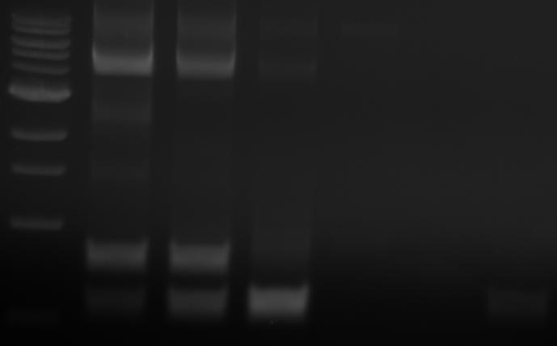
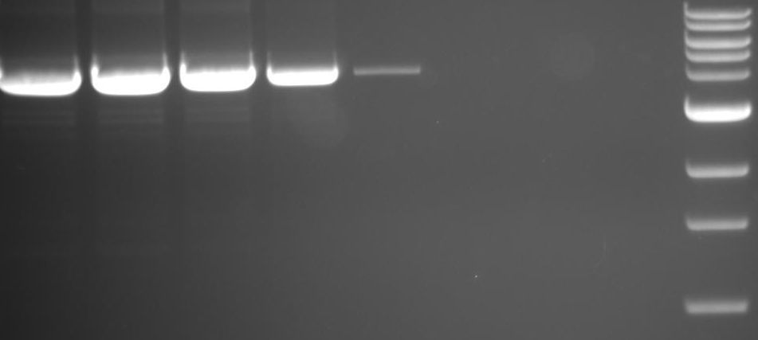
KLD Mutagenesis QC
Run 5-8uL of PCR product on a 1% agarose
Do I have a product of expected size? (*)
Is the PCR product pretty clean?
Annealing Gradient
Annealing Gradient
*
*
Expected product + other bands?
Optimize PCR
Optimize Primers
Noice and clean?
Pool Samples
Gel Purify
YOLO (Screen more colonies)
No cleanup needed (usually)
KLD Reaction
KLD Reaction

Slide 4
KLD Reaction
NEB’s KLD mix -> Nice, but $$$
Homemade KLD mix -> Works great, assemble yourself (Thank you msr2009/reddit for recipe)
That’s…it? If you’ve got a decent PCR product KLD reactions are pretty smooth.
1ul PCR product or gel purified band (5-10ng total should do it)
1ul 10X T4 DNA ligase buffer
1ul T4 PNK
1ul T4 DNA ligase
1ul DpnI
5ul H2O
----------------------
10uL total
Incubate at RT for 1 hour, transform 1uL of reaction/100uL comp. cells

Slide 5
Gibson/Goldengate 2+ Fragment prep
Prepare PCR with:
Highly accurate polymerase (Q5 or equivalent)
Long fragments? GC Enhancer Buffer VERY useful
Shorter fragments? <2-3kb? May or may not need GC enhancer -> Lowers accuracy (a bit)
LOW template amount (0.1 to 0.5 ng/25 uL PCR reaction) -> Make it easier for the DpnI
2) Thermocycling settings:
Initial Denaturation:
95°C for 90 seconds
30-40 Cycles of:
95°C for 30 seconds
50–67°C for 30 seconds
72°C for 30 seconds/kb
Final Extension:
72°C for 2X Cycling Extension Time
END
LET THE PCR MACHINE COAST TO ROOM TEMP!
PCR products can survive for DAYS at RT
Your thermocycler is not a refrigerator!
Have a gradient PCR machine?
4-12 reactions from 55-67°C
No gradient PCR?
Start at 59°C and pray

Slide 6
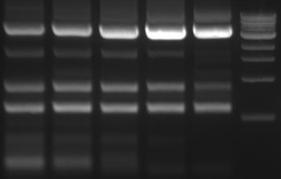
Gibson/Goldengate 2+ Fragment QC
Run 5-8uL of PCR product on a 1% agarose
Do I have a product of expected size? (*)
Is the PCR product pretty clean?
Annealing Gradient
*
*
*
*
Noice and clean?
Expected product + Nonspecific?
Optimize PCR
Optimize Primers
DpnI treatment
DpnI treatment
Less Risk
+
Slower
Gel Extraction
Protocol
Gel Extraction
Protocol
PCR Cleanup
Column
Riskier
+
Faster
NO
CLEANUP
Assembly
DO YOU FEEL LUCKY
Assembly

Slide 7
Gibson Assembly
Determine concentration of all fragments with spectrophotometer
Calculate fmol/uL for all fragments (NEB Biocalculator -> dsDNA Mass to Moles)
1 vector fragment, 1 insert? 1:3 molar ratio
1 vector fragment, 1 small insert (100-500bp)? 1:5 to 1:10 ratio
1 vector, 2 or more fragments? 1:1:1 etc ratio
Shoot for 200fmol of all fragments combined, 50fmol is grim but doable, 400+ fmol for 3+ fragment assemblies
Which mix to use?
Mix chosen depends on number of fragments to assemble and budget. Gibson/Hifi mastermix has a notoriously short shelf life! Even at -80C
1-4 Fragments?
1-3 Fragments?
2X Gibson Assembly Master Mix
405μl Isothermal Start Mix
25μl 1M DTT
20μl 25mM dNTPs
50μl NAD+ (NEB Cat. B9007S)
1μl T5 exonuclease (NEB Cat. M0363S)
31.25 μl Phusion High Fidelity DNA Polymerse (NEB Cat. M0530S)
250 μl Taq Ligase (NEB Cat. M0208S)
467.75 μl H2O
Mix by pipetting gently. Make 100 μl aliquots.
Isothermal Start Mix
1.5g PEG8000
3ml 1M Tris-HCl, pH 8.0
150μl 2M MgCl2
Put on tube rotator until PEG is in solution
Recipe/Optimization by Ethan Ford -> Ethanomics blog
1-4 Fragments?
1-5 Fragments?
5X TEDA Cloning Mix (1 mL)
500 mM Tris–HCl pH 7.5 (0.5 mL of 1M stock)
50 mM MgCl2 (50 uL of 1M stock)
50 mM dithiothreitol (100 uL of 0.5M stock)
0.25 g of PEG 8000 (May need gentle heat)
1 μl of 10 U/μl T5 exonuclease (NEB)
Commercial
Gibson Mix
(NEB or Other brands)
Commercial
Hi-fi Mix (NEB)
Combine fragments +
mastermix in 10-20uL volume
Combine fragments +
mastermix in 10-20uL volume
Combine fragments +
mastermix in 10-20uL volume
30C for 40 minutes
50C for 60 minutes
50C for 60 minutes
Combine fragments + mastermix in 10-20uL volume
50C for 60 minutes

Slide 8
Golden Gate Assembly
Determine concentration of all fragments with spectrophotometer
Calculate fmol/uL for all fragments (NEB Biocalculator -> dsDNA Mass to Moles)
1 vector fragment, 1 insert? 1:2 molar ratio
1 vector, 2 or more fragments? 1:2:2… etc ratio
Equimolar ratios can also be used
BsaI-HFv2 works best at 37°C, T4 Ligase at 16°C, so we cycle the reaction
Other restriction enzymes may be substituted for BsaI-HFv2, some require a 42°C incubation temperature
Cycling increases efficiency of multi-fragment assemblies, 2 fragment assemblies may not need cycling (but doesn’t hurt)
Cycling program can be as complex or simple as you want
1 Cycle of:
37°C for 3 minutes
16°C for 6 minutes
25 Cycles of:
37°C for 1.5 minutes
16°C for 3 minutes
1 Cycle of:
37°C for 6 minutes
80°C for 10 minutes
END
10X T4 DNA Ligase Buffer | 2 uL
Vector (50 fmol) | X uL
Insert(s) (100 fmol each) | X uL
T4 DNA Ligase | 0.5 uL
BsaI-HFv2 | 0.5 uL
dH₂O | X uL
Total | 20 uL Reaction

Slide 9
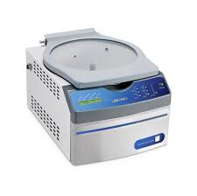
Gel Purification Protocol
Pool PCR products from multiple reactions
Anywhere from 4-12 reactions
“Can I gel purify 1 reaction?” Sure, but expect low yield…good luck downstream!
Add 0.5-1uL of DpnI to pooled reaction per 100 uL of PCR product -> 37°C for 1+ hours (Overnight is fine)
Desalt/concentrate digested PCR product with PCR Cleanup Protocol (Silica column cheat sheet)
Just concentrate PCR product and run on gel? -> Smear on agarose due to concentrated salt/buffer
Large volume difficult to load on low-melt agarose gel -> Diluted in gel volume
Silica column desalts AND concentrates pooled PCR product (Better than G50 resin, trust)
Elute in 35-50 uL if you don’t have a Centrivap, elute in 100 uL and concentrate to 35 uL if you do
Load onto low-melt agarose with a blue-light reactive dye
Ethidium bromide + UV -> Damages DNA -> Longer DNA fragments = More damage/time
Don’t have a gel comb that will fit 35-50uL? Tape a few lanes together
Cut out desired band under blue light and purify with silica column (Silica column cheat sheet)
Elute in 35-50 uL if you don’t have a Centrivap, elute in 100 uL and concentrate to 35-50 uL if you do
Determine concentration of fragments with spectrophotometer:
Less than 10ng/uL? Dicey, but doable. Consider additional PCR reactions to bulk up concentration
10-30ng/uL? Good enough depending on size of fragments
30-100ng/uL? Comfortable amount for most applications
>100ng/uL? You’re laughing! Enough for repeats!
MVP <3 I luv u

Slide 10
Assembly Controls?
More controls -> Easier to troubleshoot when things go wrong
Difficult assembly? Do more controls
Tests for:
- DpnI template degradation
Same reaction WITHOUT ligase
KLD Mutagenesis
2+ Fragment
Gibson Assembly
or
Goldengate
Each Fragment by itself
+ Gibson assembly mix
Tests for:
DpnI template degradation
Self annealing of fragments
E.g. Vector alone, Fragment 1 alone…
Transform cells with known good plasmid, pUC19, pCambia, etc
Tests for:
Bad plates
Bad antibiotics
Bad cells
All assemblies

Slide 11
Cloning Workflow
Assembled your fragments? Time to transform!
Step 1: Design Experiment/Fragments
1) 1uL KLD reaction / 100 uL Comp. cells
2) Heat shock at 42°C for 30s, Ice 2 minutes
3) Add 900 uL SOC, Recover at 37°C, 250 RPM, 1 hour
4) Spin down, discard everything except 50-100 uL, resuspend and plate
KLD Mutagenesis
Step 2: Prepare Fragments
Step 3: Assemble Fragments
2+ Fragment
Gibson Assembly***
or
Golden Gate***
1) 1-3uL Gibson/Golden Gate reaction / 100 uL Comp. cells
2) Heat shock at 42°C for 30s, Ice 2 minutes
3) Add 900 uL SOC, Recover at 37°C, 250 RPM, 1 hour
4) Spin down, discard everything except 50-100 uL, resuspend and plate
*** PEG8000 inhibits transformation, don’t transform more than 3uL! ***
*** Electroporating E.coli or Agro? 1-2uL max, high salt = more arcing! BAM! ***
Step 4: Transform Cells
Step 5: Screen Colonies
Do Stuff with Clones

