Slide 1
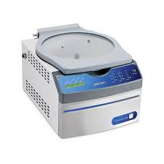
Gel Purification Protocol
Pool PCR products from multiple reactions
Anywhere from 4-12 reactions
“Can I gel purify 1 reaction?” Sure, but expect low yield…good luck downstream!
Add 0.5-1uL of DpnI to pooled reaction per 100 uL of PCR product -> 37°C for 1+ hours (Overnight is fine)
Desalt/concentrate digested PCR product with PCR Cleanup Protocol (Silica column cheat sheet)
Just concentrate PCR product and run on gel? -> Smear on agarose due to concentrated salt/buffer
Large volume difficult to load on low-melt agarose gel -> Diluted in gel volume
Silica column desalts AND concentrates pooled PCR product (Better than G50 resin, trust)
Elute in 35-50 uL if you don’t have a Centrivap, elute in 100 uL and concentrate to 35 uL if you do
Load onto low-melt agarose with a blue-light reactive dye
Ethidium bromide + UV -> Damages DNA -> Longer DNA fragments = More damage/time
Don’t have a gel comb that will fit 35-50uL? Tape a few lanes together
Cut out desired band under blue light and purify with silica column (Silica column cheat sheet)
Elute in 35-50 uL if you don’t have a Centrivap, elute in 100 uL and concentrate to 35-50 uL if you do
Determine concentration of fragments with spectrophotometer:
Less than 10ng/uL? Dicey, but doable. Consider additional PCR reactions to bulk up concentration
10-30ng/uL? Good enough depending on size of fragments
30-100ng/uL? Comfortable amount for most applications
>100ng/uL? You’re laughing! Enough for repeats!
MVP <3 I luv u

