Slide 1
KLD Mutagenesis Fragment Prep
Prepare PCR with:
Highly accurate polymerase (Q5 or equivalent)
Long plasmids? GC Enhancer Buffer VERY useful
LOW template amount (0.1 to 0.5 ng plasmid/25 uL PCR reaction) -> Make it easier for the DpnI
2) Thermocycling settings:
Initial Denaturation:
95°C for 90 seconds
30 Cycles of:
95°C for 30 seconds
50–67°C for 30 seconds
72°C for 30 seconds/kb
Final Extension:
72°C for 2X Cycling Extension Time
END
LET THE PCR MACHINE COAST TO ROOM TEMP!
PCR products can survive for DAYS at RT
Your thermocycler is not a refrigerator!
Weak band?
Bump up to 35-40 cycles
More cycles -> More non-specific bands
Have a gradient PCR machine?
4-6 reactions from 55-67 °C
No gradient PCR?
Start at 59 °C and pray

Slide 2
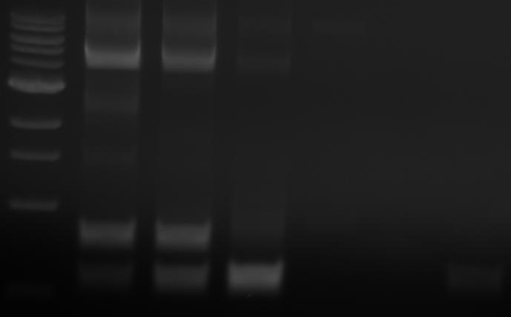
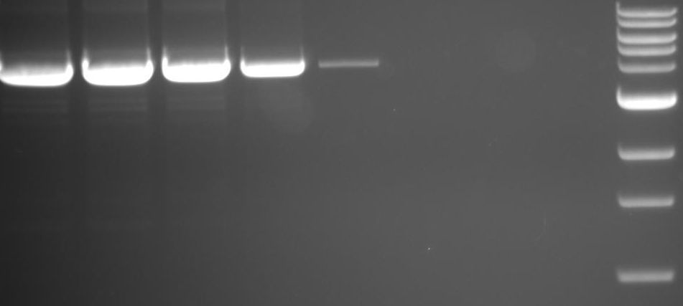
KLD Mutagenesis QC
Run 5-8uL of PCR product on a 1% agarose
Do I have a product of expected size? (*)
Is the PCR product pretty clean?
Annealing Gradient
Annealing Gradient
*
*
Expected product + other bands?
Optimize PCR
Optimize Primers
Noice and clean?
Pool Samples
Gel Purify
YOLO (Screen more colonies)
No cleanup needed (usually)
KLD Reaction
KLD Reaction

Slide 3
KLD Reaction
NEB’s KLD mix -> Nice, but $$$
Homemade KLD mix -> Works great, assemble yourself (Thank you msr2009/reddit for recipe)
That’s…it? If you’ve got a decent PCR product KLD reactions are pretty smooth.
1ul PCR product or gel purified band (5-10ng total should do it)
1ul 10X T4 DNA ligase buffer
1ul T4 PNK
1ul T4 DNA ligase
1ul DpnI
5ul H2O
----------------------
10uL total
Incubate at RT for 1 hour, transform 1uL of reaction/100uL comp. cells

